Slide 1

Air Quality Monitoring System
SUBMITTED BY
BORRA UMESH CHANDRA
RA2011044010014
UNDER THE GUIDENCE OF
Dr.S.PADMINI
ASSOCIATE PROFESSOR
Department of Electrical and Electronics Engineering

Slide 2

INTRODUCTION
Air quality monitoring using Node MCU is a modern and effective way to track air pollution in real-time. Node MCU is an open-source IoT platform that is based on the ESP8266 Wi-Fi module, which makes it easy to connect to the internet and transmit data to a remote server.
To analyze the air quality and CO level at specific area and lastly to compare the accuracy of reading. This research uses the air quality sensor MQ135 to monitor carbon monoxide, MQ7 to monitor the air quality, Overall air quality monitoring using Node MCU is an innovative and effective way to improve public health by providing accurate and timely information about air pollution levels.

Slide 3
COMPONENTS USED
Node MCU
Node MCU can be used to monitor various environmental parameters such as temperature, humidity, air quality. By deploying sensors and connecting them to Node MCU, it is possible to monitor environmental conditions in real-time.
MQ135 Gas Sensor
The MQ135 gas sensor can be used to monitor air quality in indoor and outdoor environments. By detecting the presence of harmful gases such as carbon monoxide and carbon dioxide, the sensor can help to alert people about potential health hazards.
MQ7 gas Sensor
The MQ7 gas sensor can be used to monitor CO levels in indoor environments such as homes, offices, and schools. This can help to detect the presence of CO that can cause health hazards to occupants.

Slide 4
METHODOLOGY
The inputs are the air quality MQ135 sensor and CO MQ7 sensor, interfaced with the microcontroller of this project. The microcontroller used is the Node MCU. The Node MCU connected to the output, a buzzer, and a red LED.
In general, the flow of the air quality monitoring system starts by programming the MQ135 and MQ7 to sense the air quality and the CO in the house surrounding every 5 minutes ,When the data received is higher than the range set, the buzzer will turn on, and the LED will blink to alert people in the house.
Node MCU acted as the microcontroller for this system. Since the MQ135 sensor and the MQ7 sensor are analog sensors, it is connected to the analog pin, A1 and A0, respectively. VDD pins from both sensors are linked to the 5V at the microcontroller as the supply voltages.

Slide 5
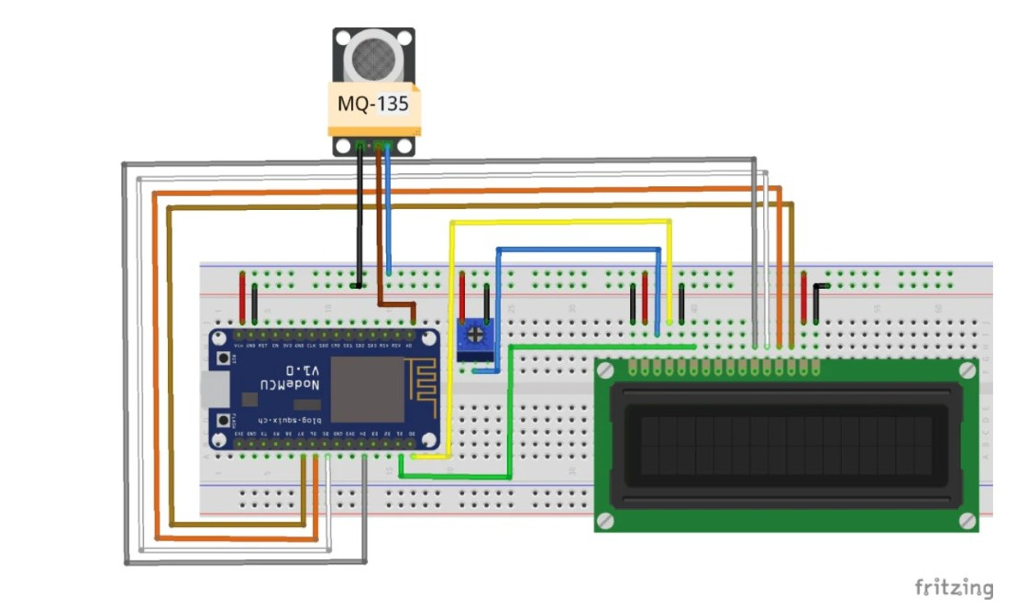

Slide 6
SOFTWARE USED
BLYNK IOT
Blynk IOT can be used to develop air quality monitoring systems that provide real-time data on air quality parameters. This data can be accessed remotely through a smartphone or web application.
AURDINO IDE
Arduino IDE provides various tools for data visualization, which can be used to create charts and graphs that display air quality data in a user-friendly format. This can help users to understand air quality data more easily and make informed decisions about their activities.

Slide 7
COST REPORT
NODE MCU 220rs
MQ7 110rs
MQ135 130rs
JUMPERS 40rs
BREADBOARD 65rs
BUZZER 15rs
LED LIGHT 02rs
TOTAL 582rs

Slide 8
CONCLUSION
In conclusion, air quality monitoring is a crucial aspect of environmental monitoring and public health. With the help of sensors such as MQ135 and MQ7, air quality parameters such as particulate matter and carbon monoxide can be measured and analyzed in real-time.
The use of IoT platforms such as Blynk and development environments such as Arduino IDE provides developers with tools and resources to create air quality monitoring systems that can provide real-time data, trigger alerts, and perform data visualization.
Overall, air quality monitoring is an important field that requires continued research and development to create efficient and effective systems that can protect public health and the environment.

Slide 9
REFERENCES
N. A. M. Kosim, S. L. M. Hassan, I. S. A. Halim, N. E. Abdullah and A. A. A. Rahim, "Air Quality Monitoring System using Arduino and Matlab Analysis," 2022 IEEE 13th Control and System Graduate Research Colloquium (ICSGRC), Shah Alam, Malaysia, 2022, pp. 225-230, doi: 10.1109/ICSGRC55096.2022.9845147.
S. Das, S. Chakraborty, D. Jana, R. Nandy and S. Bhattacharya, "IoT Based Industrial Air Quality Monitoring System," 2022 Second International Conference on Computer Science, Engineering and Applications (ICCSEA), Gunupur, India, 2022, pp. 1-4, doi: 10.1109/ICCSEA54677.2022.9936294.
https://iotdesignpro.com/
https://techexplorations.com/guides/blynk/1-what-is-blynk/
https://docs.arduino.cc/software/ide-v1/tutorials/arduino-ide-v1-basics

Slide 10

THANK YOU -RA2011044010014

